Slide 1
Ethical Mission Definition and Execution for Maritime Robotic Vehicles A Practical Approach
CRUSER TechCon
11 July 2016
Don Brutzman, Duane Davis, Curt Blais and Bob McGhee
Naval Postgraduate School (NPS), Monterey California USA

Slide 2
Motivating challenge: ethics
How can robotic systems behave ethically?
Important for military operations abroad
Civil and scientific operations also coexist daily
Not necessarily about religion or morality
Law of armed conflict internationally recognized
Often captured as Rules of Engagement (ROE) guidance for teams of national or coalition forces
Legal basis under challenge: are robots unethical?
Military readiness must be prepared for combat
Opposing forces don’t read the same memos…

Slide 3
Motivation: human-taskable maritime robots
We look to near-term future when UMVs can offload force projection, reduce danger to fleet
Variety of emerging robot solutions must remain compatible with human concepts and tasking
Necessary for mission planning and justification
Otherwise the robots are simply not autonomous
Extensive/exhaustive prelaunch testing is critical
For mission confidence and in-water reliability
This work is building an extendable architecture…
… for continued efforts bridging human, robot logic
Notes:
Prelaunch testing includes both human and software rehearsal.

Slide 4
Practical approach
Define missions that integrate ethical constraints without relying on artificial intelligence (AI) or obscure abstractions for appropriate behavior
No embedded homunculus or abstract ethicist engine
Design robot missions in way that can be adapted to a variety of disparate robot paradigms
Generally adaptable to tasking of diverse systems
Build on patterns that work well for human groups cooperating on difficult, dangerous tasks
Human accountability remains central
Otherwise still need human at end of remote tether

Slide 5
Key insight #1
Humans in military units are able to deal with moral challenges without ethical quandaries
Careful definitions are provided for
Tasks, missions, objectives, coordinated operations
Ethical constraints and rules of engagement
These allow both measured and rapid response, independently and cooperatively
Commanders do not deploy illegal, immoral weapons
Unmanned systems must also pass similar scrutiny, otherwise commanders cannot utilize them

Slide 6
Enabling factor: maritime environment
Major international controversy unfolding: drone use for conduct of reduced-risk warfare
Many factors involved: technical, political, social
Remote human “control” is highly questionable
Complex, confounded environments
Maritime environment is much less ambiguous
Fewer IFFN issues, identification friend foe neutral
Presence of bad actors usually confirmable
Law of Sea, Laws of Armed Conflict, etc.

Slide 7
Goal-based Mission Example
Simple yet general mission goals, decision logic
Common approach, adaptable to other vehicles
Extendable and refinable mission tasking

Slide 8
Example Goal-based Mission Definition
Goal 1. Proceed to Area A and search the area. If the search is successful execute Goal 2. If the search is unsuccessful, execute Goal 3.
Goal 2. Obtain environment sample from Area A. If the sample is obtained, execute Goal 3. If the sample cannot be obtained, proceed to recovery position to complete the mission.
Goal 3. Proceed to Area B and search the area. Upon search success or failure, execute Goal 4.
Goal 4. Proceed to Area C, rendezvous with UUV-2. Upon rendezvous success or failure, transit to recovery position to complete the mission.
Notes:
Clumsy but readable. Humans can agree on intent.

Slide 9
Goal-based Mission Example
Robot mission conduct
can be independent of
software implementation
Strategic Level
Tactical Level
MEA Start
Tactics module sequencer
Phase 1: Search Area A
Fail
Succeed
Sample Environment Phase Controller
Area Definition
Phase 2:
Sample Environment in Area A
Queries
Sampling Requirements
Phase 3: Search Area B
Operational and Ethical Constraints Checking
Responses: Succeed
or Fail
System State and Sensor Data
Vehicle
Commands
Fail
Succeed
Succeed
Fail
Tactical-Level modules with shared vehicle state
and telemetry history
Phase 4: Rendezvous with
UUV-2 in Area C
Succeed
Phase 5: Transit
Return to Base
Fail
Controller Parameters
Fail
Succeed
Sensor Settings, Responses
Real-time orders
Mission Abort
Mission Complete
Execution Level
handles real-time control and response
Surface
Recovery position
Notes:
Right hand side: our robot architecture handles these task assignments one way. Another robot architecture may handle it a different way. Each however can be expected to sufficiently capable to report success or failure of each assignment. If not, then that robot is unresponsive and not really taskable with confidence by humans.

Slide 10
Adding ethical constraints to mission requirements
Following the leader:
how do human teams accomplish tasks ethically?
The same rules need to apply to unmanned systems.

Slide 11
Key insight #2
Ethical behaviors don’t define the mission plan.
rather
Ethical constraints inform the mission plan.

Slide 12
Example ethical constraints: civil
Safe navigation, follow pertinent rules of road
Satisfactory navigational accuracy (GPS etc.)
Have received timely clearance to enter a specific geographic area for given time period
Also vertical clearance for underwater depth zone or airborne altitude zone
Sufficient vehicle health, power, safety status
Meet communication requirements for tasking
Identity beacon, transponder, AIS tracking, etc.
Recording and reporting on situational data, etc.

Slide 13
Civil ethical constraint support in AVCL, AUV Workbench
Civil ethical constraints | Define | Test | Notes
Mission tasking | √ | partial | AVCL goals
Safe navigation and transit | √ | √ | AVCL avoidance areas
Follow pertinent rules of road |  |  | Requires rule-engine path planner, sensing model
Satisfactory navigational accuracy (GPS etc.) | √ | √ | Needed: sensor error models
Clearance to enter a specific geographic area | √ | √
Vertical clearance for underwater depth zone or airborne altitude zone | √ | √
Timing requirements using specific times or duration | √ | √
Sufficient vehicle health, power, safety status | partial | partial
Meet communication requirements for tasking | partial | partial | Message-passing scheme
Identity beacon, transponder, AIS tracking, etc.
Recording and reporting on situational data

Slide 14
Example ethical constraints: military
Meet all relevant, international civil requirements
Identification friend foe (IFF), blue-force tracking
friendly/hostile/neutral/unknown
Prior determination of contact’s hostile intent
Robot option to warn without fear of self protection
ROE use of deadly force, weapons releasability
Brevity codes: weapons safe, hold, tight, free
Confirmation and permission requirements
After-action reporting, damage assessment
Et cetera, et cetera…

Slide 15
Military ethical constraint support in AVCL, AUV Workbench
Military ethical constraints | Define | Test | Notes
Meet all relevant, international civil requirements | partial | partial | See above
Mission tasking | √ | partial | AVCL goals
Contact identification, tracking signatures |  |  | Available in C2 systems
Identification friend foe (IFF), blue-force tracking (friendly/hostile/neutral/unknown/etc.) |  |  | Available in C2 data models
Robot option to warn without fear of self protection |  |  | Implementable via messaging
Determination of contact’s hostile intent |  |  | Available in C2 data models, dissertation work in progress
Confirmation and permission requirements |  |  | Implementable via messaging
ROE use of deadly force, weapons releasability using brevity codes: weapons safe, hold, tight, free | partial | partial | Requires weapons model
Proportional weapons response |  |  | Requires weapons and threat models
After-action reporting | partial | partial | AVCL goals
Damage assessment |  |  | Requires models of interest
Notes:
http://en.wikipedia.org/wiki/Brevity_code

Slide 16
Goal-based Mission Example, with constraints
Strategic Level
Tactical Level
MEA Start
Tactics module sequencer
Constraint
Phase 1: Search Area A
Fail
Succeed
Sample Environment Phase Controller
Area Definition
Phase 2:
Sample Environment in Area A
Queries
Sampling Requirements
Phase 3: Search Area B
Operational and Ethical Constraints Checking
Constraint
Responses: Succeed
or
Fail
or
Constraint Violation
Constraint
System State and Sensor Data
Vehicle
Commands
Fail
Succeed
Succeed
Fail
Tactical-Level modules with shared vehicle state
and telemetry history
Phase 4: Rendezvous with
UUV-2 in Area C
Succeed
Phase 5: Transit
Return to Base
Fail
Constraint
Constraint
Controller Parameters
Fail
Succeed
Sensor Settings, Responses
Real-time orders
Mission Abort
Mission Complete
Execution Level
handles real-time control and response
Surface
Recovery position

Slide 17
Constraints applied to sample mission
Constraint 1: The vehicle must maintain navigational accuracy within acceptable limits. * Applies to entire mission.
Constraint 2: All safety equipment must be fully functional. *
Constraint 3: All mission systems must be operational. Applies to Goal 1, Goal 2, and Goal 3.
Constraint 4: Acceptable distance from shipping lanes in the form of 1000 meter lateral standoff or minimum depth of 20 meters must be maintained. Applies to Goal 1, Goal 2, Goal 3, and Goal 4.
Constraint 5: Must be able to detect surface contacts within 5000 meters. *
Constraint 6: Detected surface contacts are to be avoided by a minimum of 1000 meters. Applies to Goal 1, Goal 2, Goal 3, and Goal 4.
Constraint 7: Minimum depth of 20 meters is to be maintained. Applies to Goal 5.

Slide 18
Challenge: broad implementation
Can we
Define mission goals readable by humans + robots
Produce actionable tasking for different AUVs
Produce software examples that can run properly in simulation and in robots
Can we also
Define goal constraints ethically and measurably
Yes
Initial tests successful

Slide 19
Autonomous Vehicle Command Language (AVCL)
AVCL is a command and control language for humans running autonomous unmanned vehicles
Close correspondence to human naval terminology
Common XML representations for mission scripts, agenda plans, and post-mission recorded telemetry
Operators can utilize a single archivable and validatable format for robot tasking, results
directly convertible to and from a wide variety of different robot command languages
https://savage.nps.edu/Savage/AuvWorkbench/AVCL/AVCL.html

Slide 20
Example mission, as pseudo-code XML
<?xml version="1.0" encoding="UTF-8"?>
<UUVMission>
<GoalSet>
<Goal area=”A” id=”goal1”>
<Search nextOnSucceed=”goal2” nextOnFail=”goal3”/>
</Goal>
<Goal area=”A” id=”goal2”>
<SampleEnvironment nextOnSucceed=”goal3” nextOnFail=”recover”/>
</Goal>
<Goal area=”B” id=”goal3”>
<Search nextOnSucceed=”goal4” nextOnFail=”goal4”/>
</Goal>
<Goal area=”C” id=”goal4”>
<Rendezvous nextOnSucceed=”recover” nextOnFail=”recover”/>
</Goal>
<Goal area=”recoveryPosition” id=”recover”>
<Transit nextOnSucceed=”missionComplete” nextOnFail=”missionAbort”/>
</Goal>
</GoalSet>
</UUVMission>
XML is readable by human or robot,
captures logic of canonical mission

Slide 21
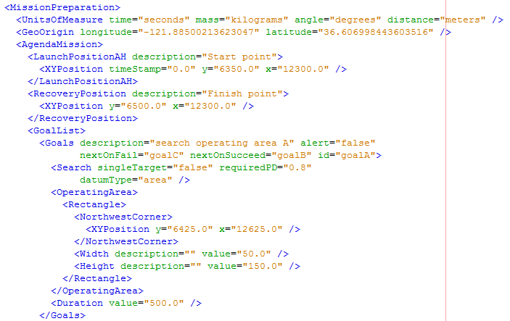
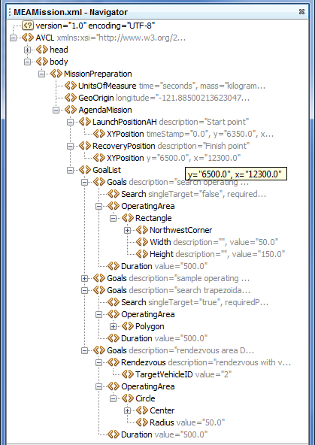
Corresponding example: MEAMission.xml using AVCL xml

Slide 22
AVCL mission goals support
AVCL mission goals | Define | Test | Definition
Attack | partial |  | To conduct a type of offensive action characterized by employment of firepower and maneuver to close with and destroy an enemy.
Decontaminate | √ |  | To provide purification making an area safe by absorbing, destroying, neutralizing, making harmless, or removing chemical, biological, or nuclear contamination.
Demolish | √ |  | To destroy structures, facilities, or material by any available means.
IlluminateArea | √ |  | To provide locale lighting by searchlight or pyrotechnics.
Jam | √ |  | To deliberately radiate, re-radiate or reflect electromagnetic energy with the object of impairing the use of electronic devices or systems.
MarkTarget | √ |  | To make visible (by the use of light, infrared, laser, smoke, etc.) of an object in order to allow its identification by another object.
MonitorTransmissions | √ |  | To conduct electronic warfare support operations with a view to searching, locating, recording and analyzing radiated electromagnetic energy.
Patrol | √ | √ | To gather information or carry out a security mission.
Rendezvous | √ | partial | Achieve a meeting at a specified time and place.
Reposition | √ | √ | To change position from one location to another.
SampleEnvironment | partial |  | Collect environmental samples for testing for chemical compounds, biological creatures, or nuclear hazards.
Search | √ | √ | To look for lost or unlocated objects or persons.

Slide 23
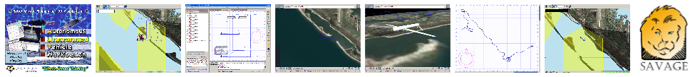
AUV Workbench
Example
open-source
implementation
Autonomous Unmanned Vehicle Workbench supports underwater, surface and air vehicles
physics-based mission rehearsal
real-time task-level control of robot missions, and
replay of recorded results
Industry-friendly open-source license, Sourceforge
Basis: RBM 3-level architecture, AVCL commands
Used to rehearse strategic-level MEAMission.xml
https://savage.nps.edu/AuvWorkbench

Slide 24
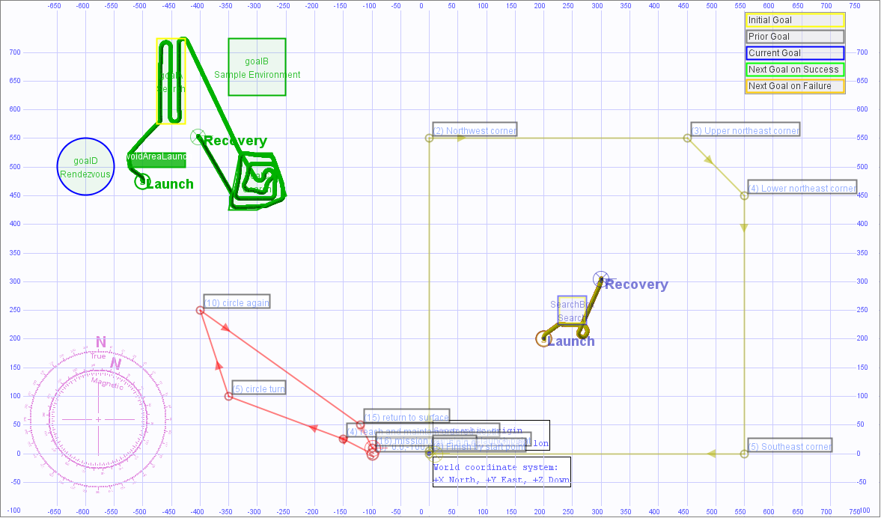
4 example missions, UUV and USV

Slide 25
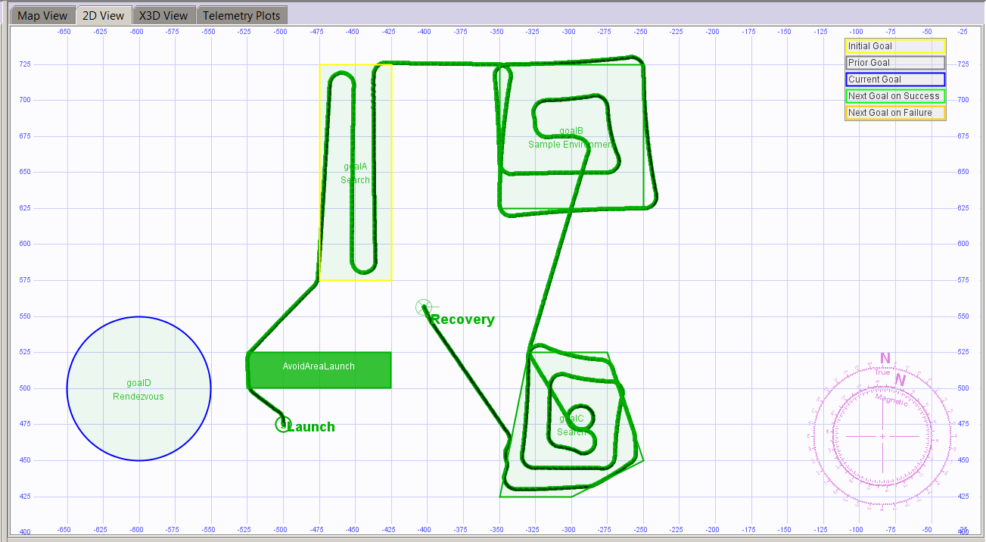
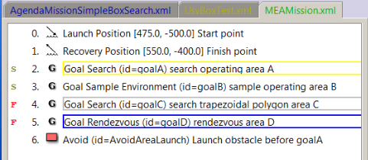
MeaMission.xml simulation preview
Search planning
produces waypoints
All events logged
Recovery
Launch
Rendezvous not supported
All searches complete
Notes:
These results are similar to the previously shown user-driven example #3: rendezvous attempt fails, so robot returns for recovery

Slide 26
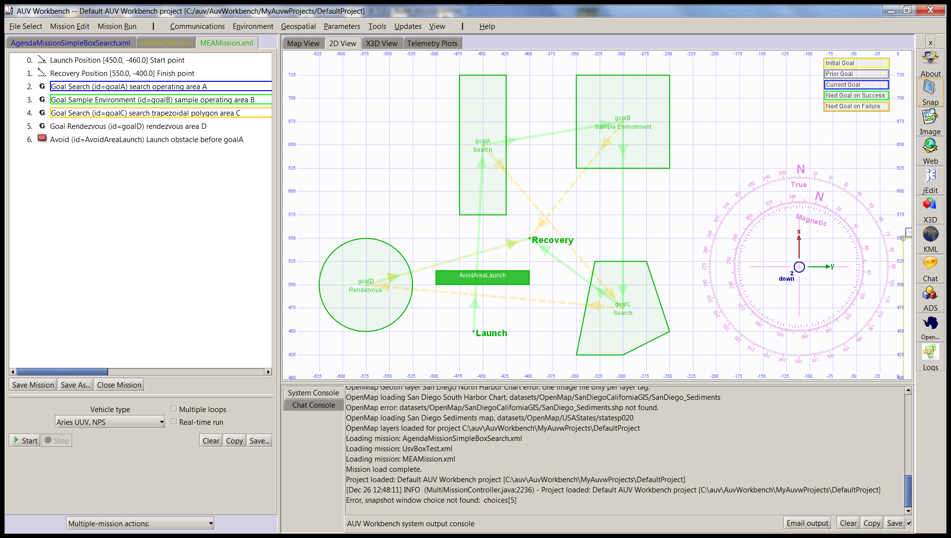
MeaMission.xml simulation 0, launch

Slide 27
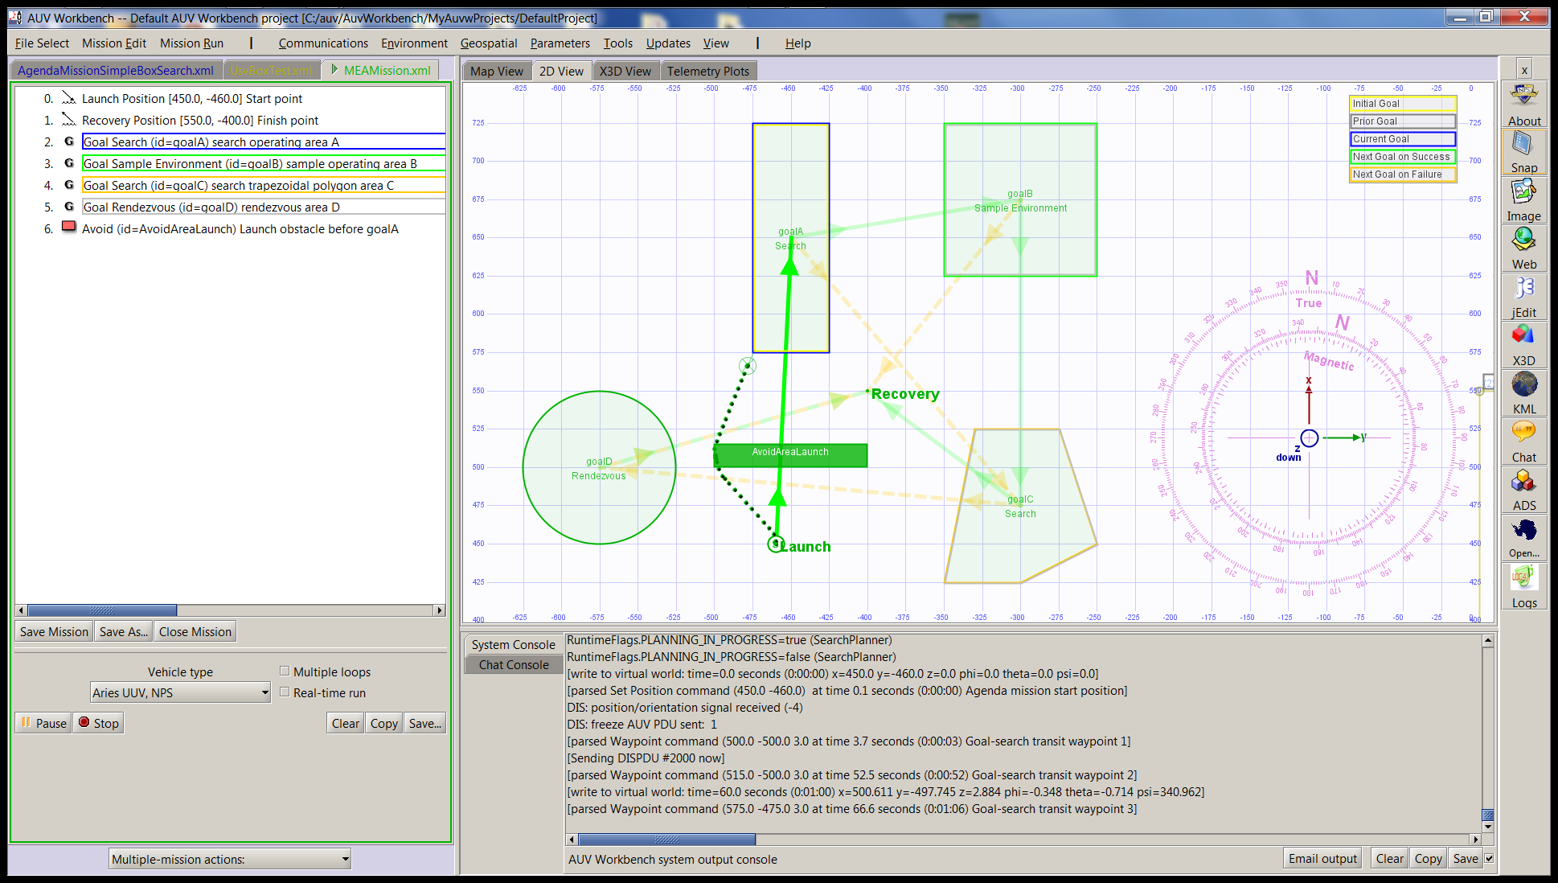
MeaMission.xml simulation 1, transit

Slide 28
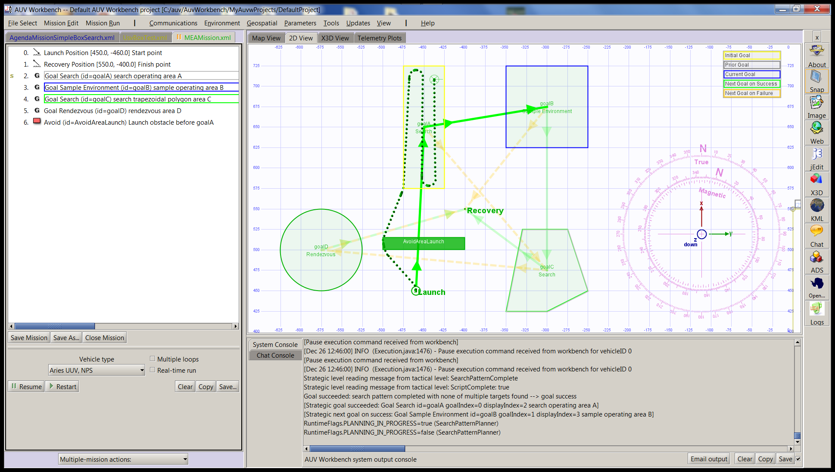
MeaMission.xml simulation 2, search

Slide 29
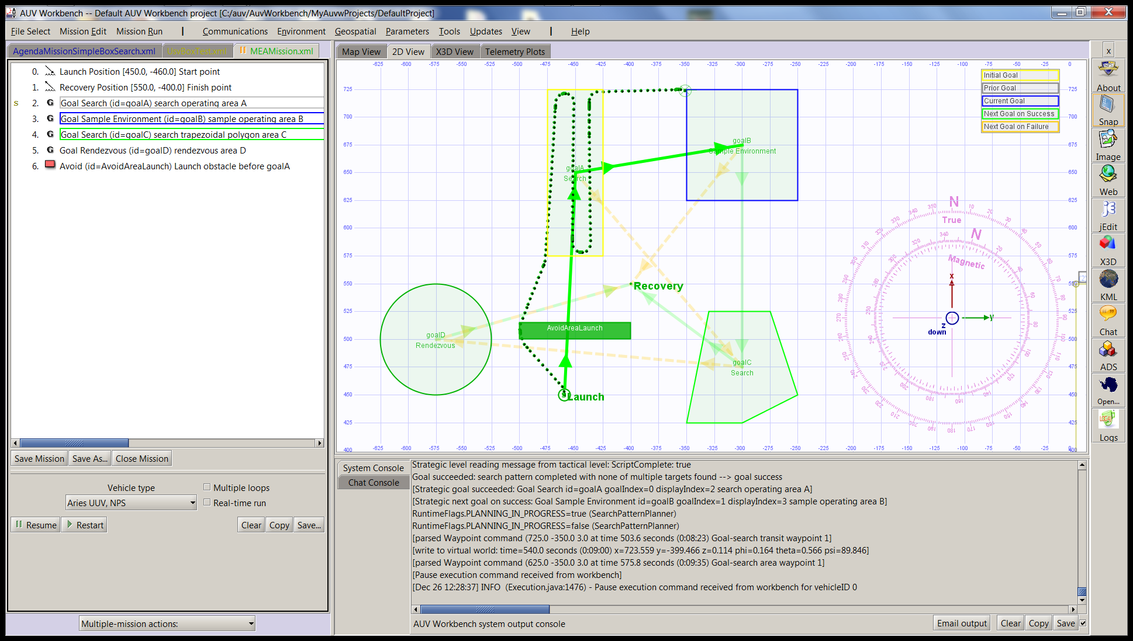
MeaMission.xml simulation 3, transit

Slide 30
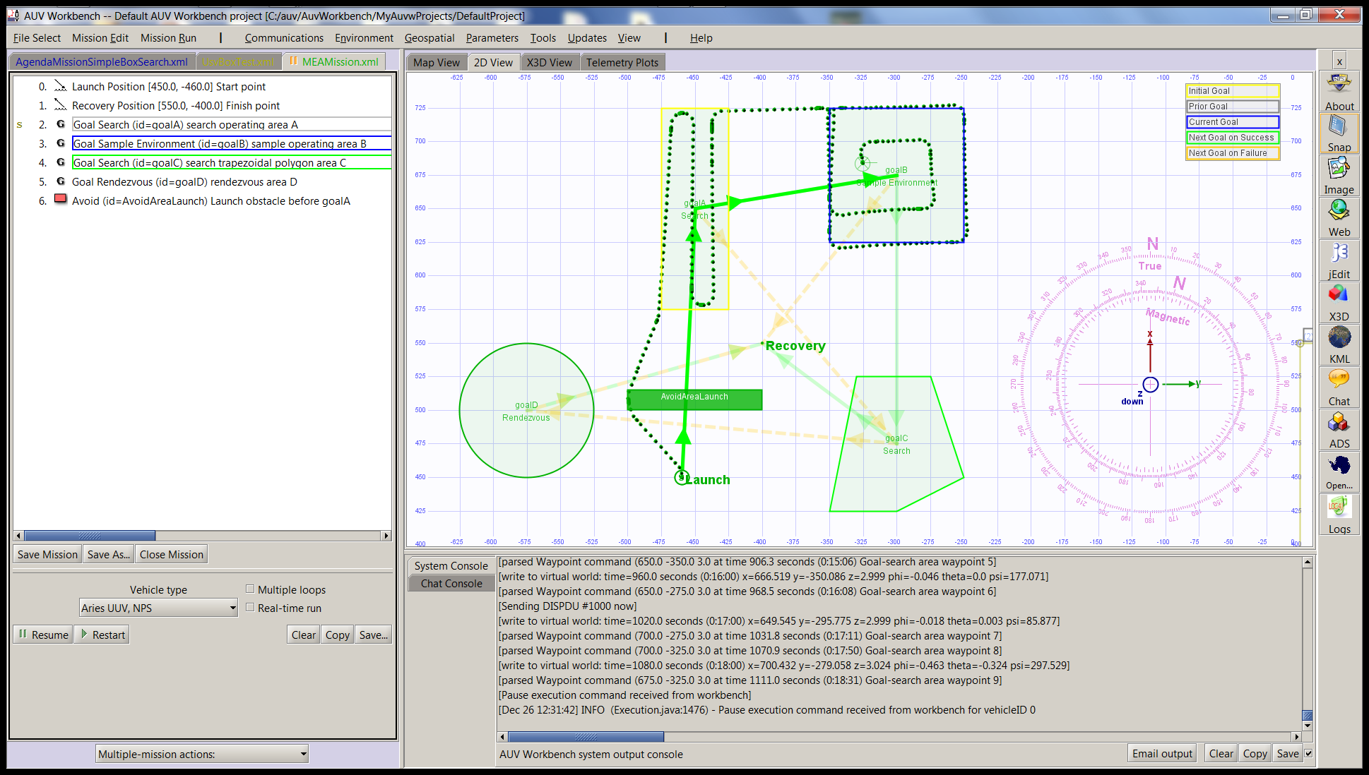
MeaMission.xml simulation 4, sample

Slide 31
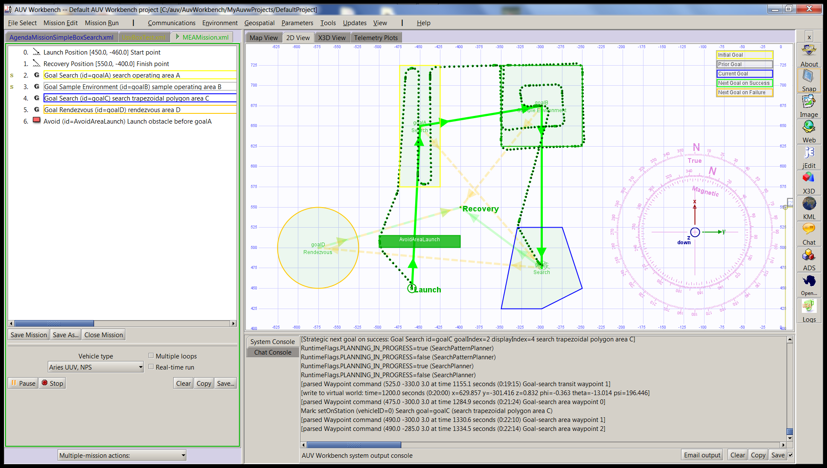
MeaMission.xml simulation 5, transit

Slide 32
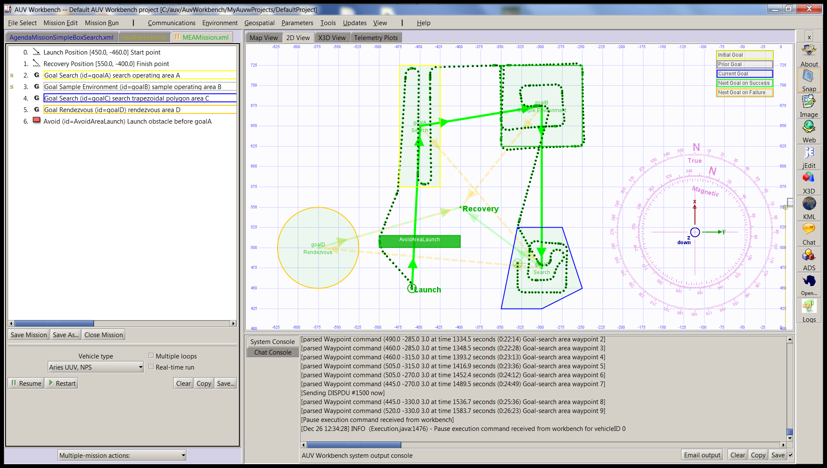
MeaMission.xml simulation 6, search

Slide 33
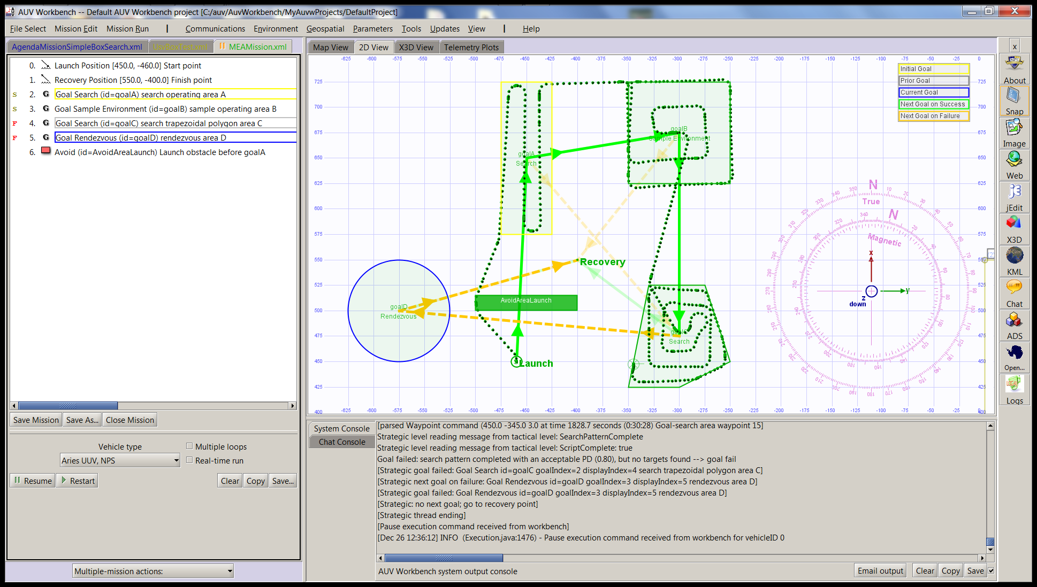
MeaMission.xml simulation 7, rdvu fail

Slide 34
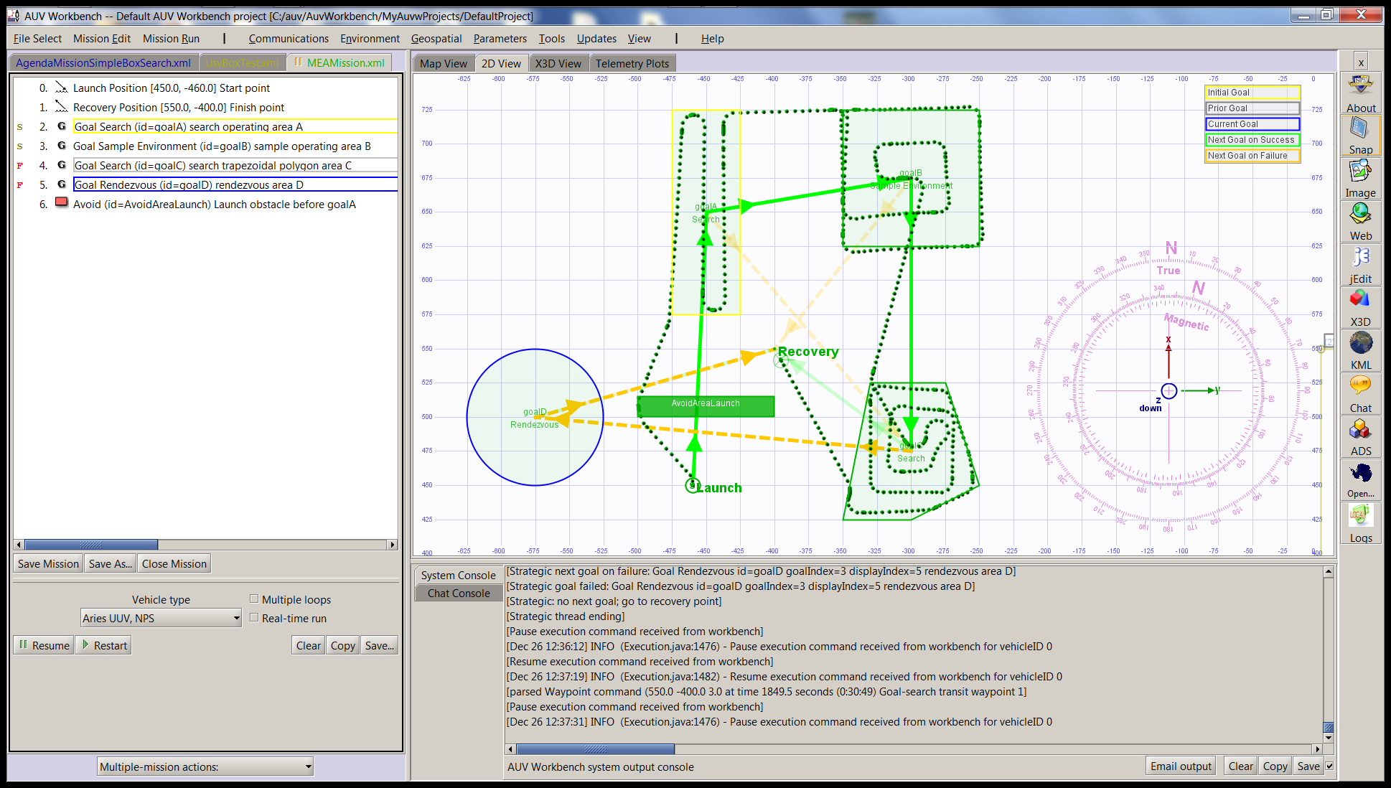
MeaMission.xml simulation 8, transit

Slide 35
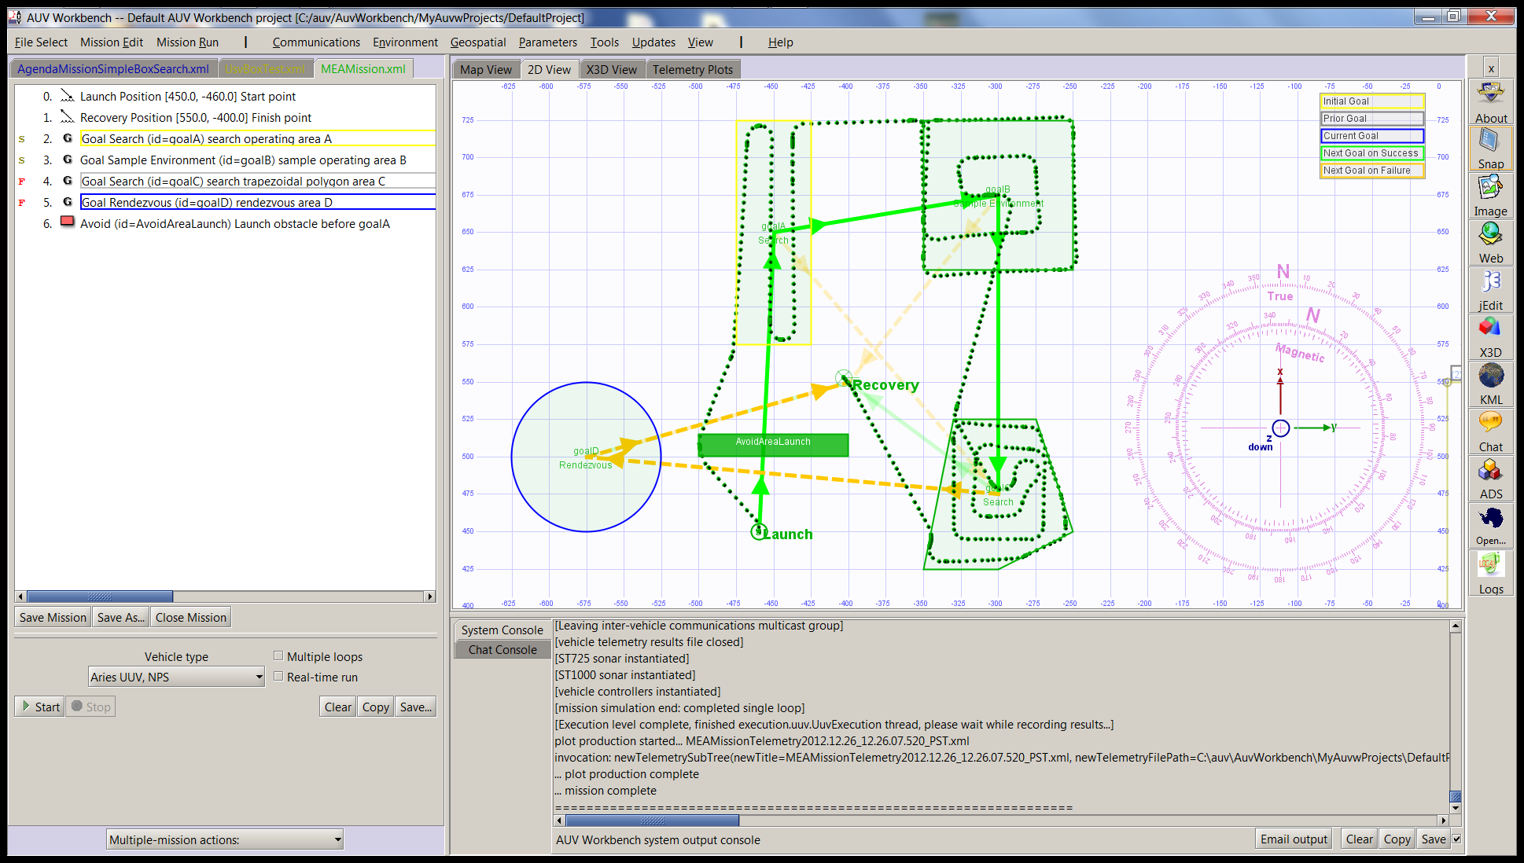
MeaMission.xml simulation 9, recovery

Slide 36
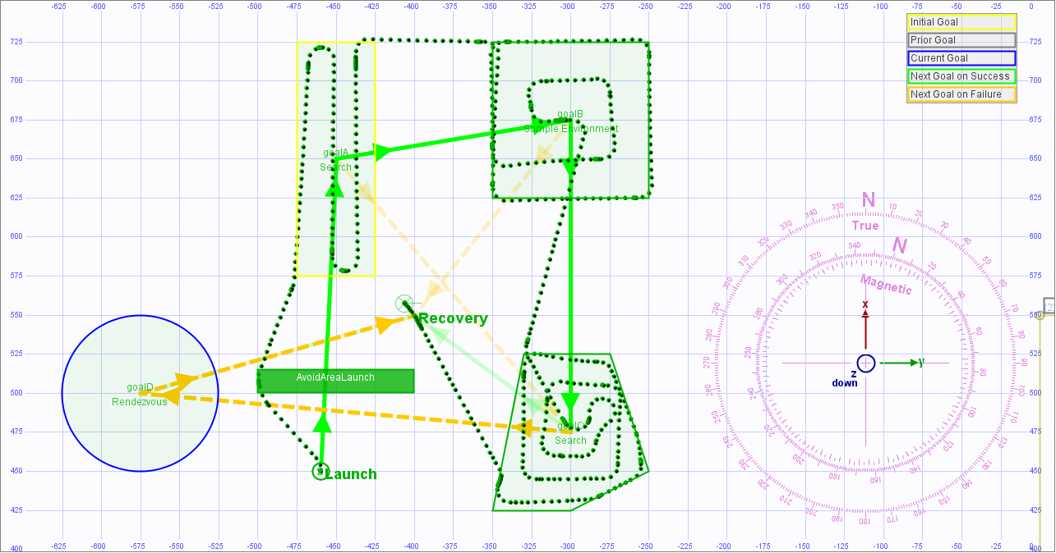
MeaMission.xml simulation 10, complete

Slide 37
Mission definition observations
MEA formalism assumes human generation of mission orders
Example expressed using AVCL
Can also be expressed in other languages such as Java, Prolog, CLIPS rule sets, C++, etc.
As shown in multiple RBM theses, dissertations
Key insight #3. Naval forces can only command mission orders that are:
Understandable by (legally culpable) humans
Reliably and safely executable by robots
Notes:
This presentation demonstrates 2 implementations illustrating the example mission

Slide 38
Humans + system validation that orders are well-defined together with ethically sound constraints

Slide 39
Mission Execution Ontology (MEO)
Semantic Web supports well-defined expression of logical rules and relationships
Mission goals, capabilities, tasks and ethical requirements can be defined formally
With tractable computation by reasoning engines
MEO applies Web Ontology Language (OWL), Resource Description Framework (RDF) lets mission correctness be validated logically
Open standards, World Wide Web Consortium (W3C)
Multiple proven implementations available

Slide 40
Responsibility and accountability
Culpability, liability are problematic for AI agents
Command responsibility must be accompanied by Authority and Accountability
In this approach, humans remain responsible for correct mission tasking and approval of ethical constraints – preserving necessary oversight for release of potentially lethal force.
.

Slide 41
Unmanned Vehicle Ethics Ontology
Concepts
Roles
Mission
Dashes indicate roles or concepts defined in terms of other roles or concepts
has_constraint
applies_to
can_perform
performable_by
15 October 2014
starts_with
includes
is_next
Constraint
applies_to
Goal
has_capability
Vehicle
end_state
follows
can_identify
has_feature
End_ Condition
requires
meets_requirement
Goal_ Requirement
can_fulfill
Vehicle_ Feature
can_test

Slide 42
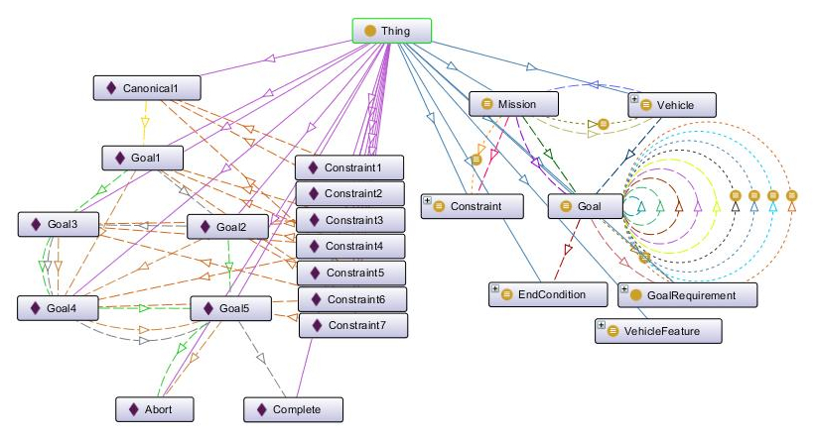
Example Mission Validation using Protégé Tool

Slide 43
Review of take-away points
Humans in military units effectively deal with moral challenges without ethical quandaries.
Ethical behaviors don’t define mission plans; ethical constraints inform mission plans.
Naval personnel can only issue orders that are:
Understandable by (legally culpable) humans, and
Reliably and safely executable by robots.
Robot mission tasking can be carefully reviewed and approved by humans, with formal validation of correctness and ethical completeness.

Slide 44
Influential student theses now possible
Define, explore core missions for today’s Navy
Use scenario simulations to test ethical challenges related to autonomous robot lethality
Apply ethical tasking to many unmanned systems, support military human-robot team concepts

Slide 45
Contact
Don Brutzman, Ph.D.
brutzman@nps.navy.mil
brutzman@nps.navy.smil.mil
http://faculty.nps.edu/brutzman
Code USW/Br, Naval Postgraduate School
Monterey California 93943-5000 USA
1.831.656.2149 work
1.831.402.4809 cell

Slide 46
Contact
Duane Davis, Ph.D.
dtdavi1@nps.edu
Code CS/Da
Naval Postgraduate School
Monterey California 93943-5000 USA
1.831.656.7980 work

Slide 47
Contact
Curt Blais
clblais@nps.edu
Code MV/Bl
Naval Postgraduate School
Monterey California 93943-5000 USA
1.831.656.3215 work

Slide 48
Contact
Robert B. McGhee, Ph.D.
robertbmcghee@gmail.com
Professor Emeritus
Computer Science
Naval Postgraduate School
Monterey California 93943-5000 USA

Slide 49


ETHICAL MISSION TASKING AND EXECUTION FOR MARITIME ROBOTS
Lethality requires ethical & legal basis, supervised by military teams.
Effective robot tasking can resemble tactical tasking of humans afloat.
Careful application of goal constraints makes ethical control feasible.
Robot missions then complement and extend naval operation orders.
Semantic Web logic can confirm ethical correctness and completeness.
Next steps: extend 2 decades of work with simulation scenario testing.
Draft paper, IEEE/MTS OCEANS 2016 Conference, Monterey CA, 19-23 SEP 2016.
Authors Don Brutzman, Duane Davis, Curtis Blais, and Robert McGhee, NPS.
Review requests and feedback are welcome. Contact: brutzman@nps.edu
“Ethical constraints on robot mission execution are possible today. There is no need to wait for future developments in Artificial Intelligence (AI). It is a moral imperative that ethical constraints in some form be introduced immediately into the software of all robots that are capable of inflicting unintended or deliberate harm to humans or property.” - Robert McGhee, April 2016
Notes:
https://zxing.appspot.com/generator
ETHICAL MISSION TASKING AND EXECUTION FOR MARITIME ROBOTS: A PRACTICAL APPROACH, draft paper for IEEE/MTS 2016.
All review comments welcome. Please send requests to brutzman@nps.edu

